Slide 1

Adventures in Fuzzing
Notes:
Hello

Slide 2

A bit about me
Brandon Falk
I specialize in binary fuzzing
Specifically I specialize in harnessing
Unique ways of observing programs under test
Gathering coverage (code/memory/register/state)
Catching crashes and performing input feedback
More performant fuzzing
I tweet: @gamozolabs
I blog: https://gamozolabs.github.io/
I tube: https://www.youtube.com/user/gamozolabs
Notes:
Emphasis on binary fuzzing. I’m no expert in fuzzing web or interpreted languages
That’s my Halloween outfit for 2018, anyone know the reference?

Slide 3
So what is fuzzing?

Slide 4

Fuzzing
Often used for file formats or networking protocols
Easy to set up
Almost no compute requirements for simple programs
Generating/mutating inputs for a program
Large set of valid inputs (corpus) mixed together and corrupted
Read a specification for a protocol, design something to make valid traffic
Goal of creating an exceptional condition
Program crash
Unique errors
Hangs
Notes:
Probably the biggest source for security bugs
However most of the nutty exploits are through just reading code

Slide 5
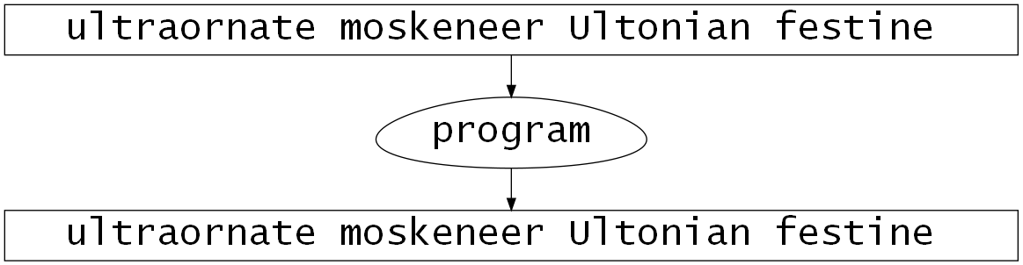
Fuzzing Visualized
Notes:
Just showing random inputs

Slide 6
Standard Fuzz Cycle
Gather sample inputs
Mutate
Program
Crash
Generate inputs
Triage and Report
Notes:
Typically fuzzing starts with a generator, or a mutator.
Sometimes both
Note there’s really no exploring here
If crashing is rolling a 6 on a die, and your fuzzer cannot generate a 6, it will never crash

Slide 7
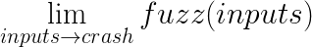
Limitations of Fuzzing
Generating all valid inputs is nearly impossible
Custom protocol extensions hard to know about without reversing
Non-crashing bugs typically not found
Arbitrary file read
SQL injection
Magical privilege escalation
Hard to interpret progress
No crashes? Are there no bugs? Is your fuzzer not working?
Loads of crashes? Maybe it’s working? Maybe you’re finding 1% of the bugs?
Most off the shelf tooling requires source
Notes:
A fuzzer isn’t going to find an auth bypass unless you have it checking permissions for changes
Really anything that doesn’t crash wont be caught

Slide 8
Harnessing? What do you mean?

Slide 9
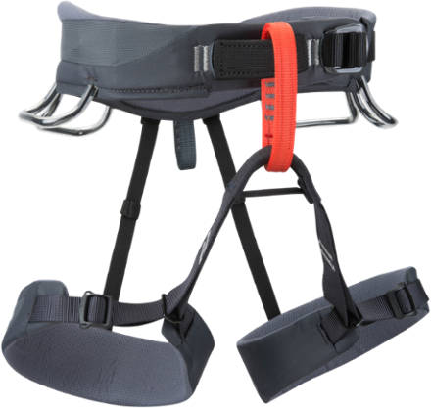
Harness
The tooling used to observe program behavior
Debugger watching for crashes
Code coverage instrumentation by a compiler
Emulators/hypervisors to observe a whole system
What are they looking for?
Crashes
Code coverage
Unexpected program states
Error messages
Information leakage
Notes:
This is where I specialize
There really aren’t many harnesses in the public world compared to generators/mutators/etc
There’s really no strict definition but I would consider something that monitors for crashes and provides a mechanism for supplying inputs and recording inputs is a harness. Further I think a harness restarts the program on crashes, etc. Really it just facilities fuzzing.

Slide 10
Examples
Common off-the-shelf fuzzing tools

Slide 11
Just Invoking the Program
Usually the right place to start
Write some tool that generates a mutated file
Run the program to parse the file
What if we get a crash?
Ehh… just attach GDB or WinDbg or enable core dumps :D
Reproducibility can be a huge issue
Can be impossible to scale as the program can only have one instance
Program startup times can be long (seconds to open up Word)
Notes:
Really crude, really fast, really effective
Most targets need not more than this to start off

Slide 12
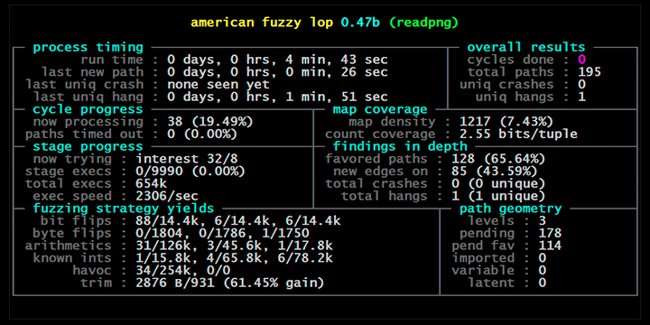
AFL
The gold standard
Looks to be being replaced slowly by libfuzzer in popularity
Coverage guided
Relies on having source in standard configuration
Can use QEMU for coverage
Notes:
AFL is really biased towards file-based fuzzing. Performance and scaling can be quite bad as the syscall load is high. Can be mitigated with persistent mode

Slide 13

libfuzzer
Designed to be baked into your target application
Part of LLVM, easily used when building a target with clang
Coverage guided
Requires source
Extremely fast as it’s in-memory fuzzing
Not dropping files to disk every iteration
Similar to AFL it’s corpus based
Need to have some well formed inputs to start with
Notes:
Personally I’ve never used libfuzzer. I just want to be clear that I don’t really understand this and can’t speak to it effectively

Slide 14
Architectural Improvements to Fuzzing
Target agnostic generic improvements to fuzzing as a whole

Slide 15
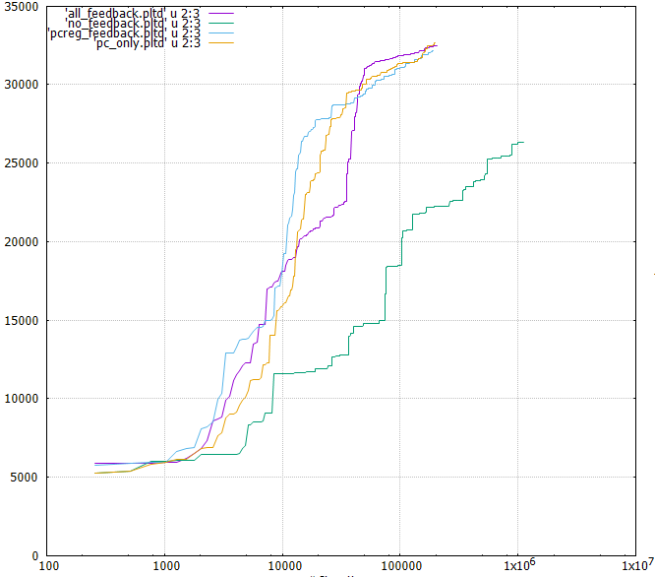
Coverage Guided Fuzzing
Gather which code has been hit based on an input
Input saved when a new unique codepath is observed
Input is used as a basis for future inputs
One of the biggest improvements that can be made to a fuzzer
Can ultimately turn exponential complexity into linear complexity
Notes:
Without coverage you discard everything you compute
You spend 10,000 hours of CPU time fuzzing and yet you only save about 10 minutes worth of fuzzing

Slide 16
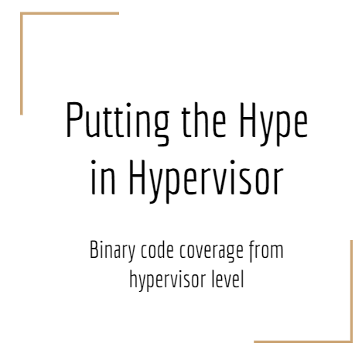
Coverage Guided Fuzzing
Gathering coverage
Instrumentation during compile time (requires source, most common)
Using an emulator
Random sampling/profiling
Hardware tracing features (Intel Processor Trace, AMD’s BHTraceCTL)
Order of magnitude improvement in time-to-same-coverage
Typically 20-30% more coverage in general
Notes:
Time-to-same-coverage is just that you get the same coverage in less time. Eg. 100k blocks of coverage in 10 minutes vs 100 minutes.
See the resources slide for the link to the “Putting the Hype in Hypervisor” slides. I think there’s a recording out there too I could maybe find.

Slide 17
Coverage Guided Fuzzing Example
Write a program to remove all occurrences of the word “the” in a sentence
The cow jumped over the moon
The car is orange
Program
Cow jumped over moon
Car is orange

Slide 18
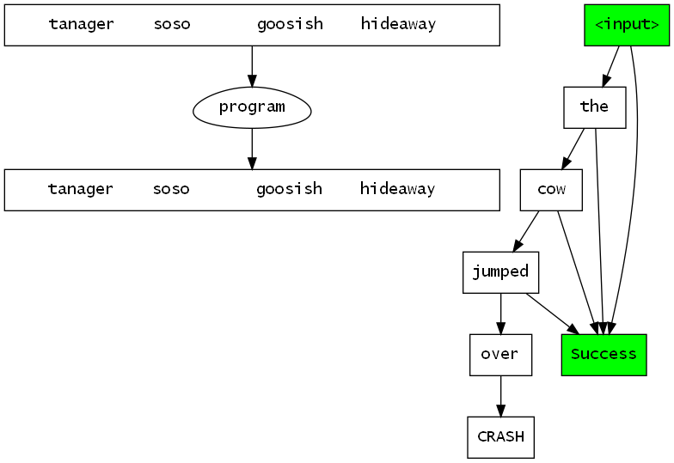
Coverage Guided Fuzzing Visualized
Notes:
As new coverage is found the input “latches” previous known good states
This allows us to build on old inputs that hit unique states. This has huge benefits for programs that are branch heavy

Slide 19
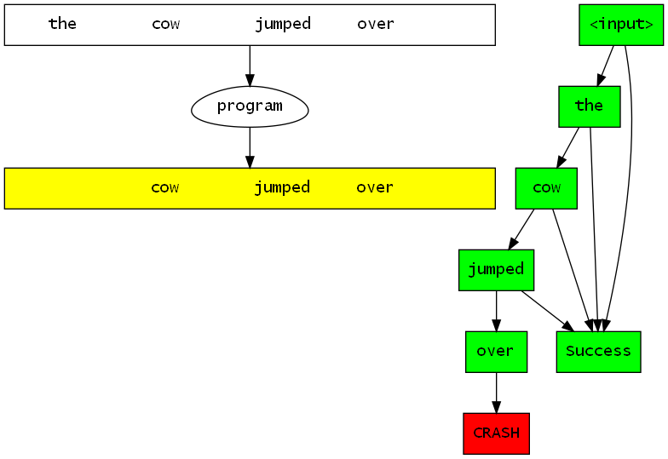
Coverage Guided Fuzzing Visualized

Slide 20
Feedback Fuzz Cycle
Coverage Reports
Coverage
Gather sample inputs
Mutate
Program
Crash
Generate inputs
Triage and Report
Notes:
Feeding back crashes is usually not feasible unless you are using a harness that can quickly handle and reset from crashes
If it takes 5 seconds for your program to restart after a crash, crash feedback will kill your fuzzer uptime
Coverage reports can be looked at by a human to determine the amount of missed code
This human analysis can help guide further generator/mutator design such that the missed paths are hit

Slide 21
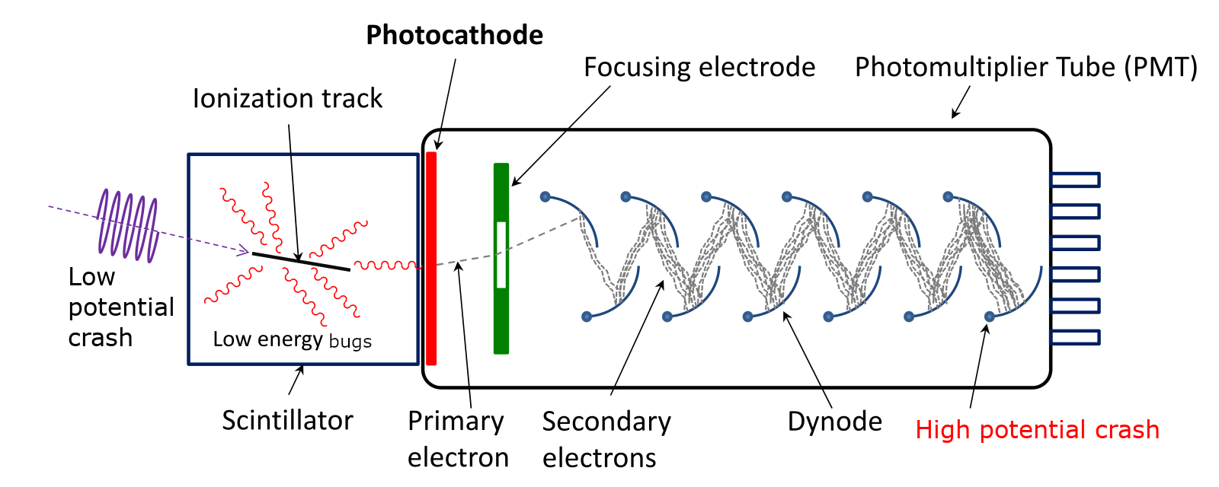
Crash Amplification
Increase program sensitivity to malformed input
ASAN / PageHeap / Electric Fence
Add hooks to find logic bugs (e.g. crash on auth success)
Notes:
Do anything you can to increase crashes
Add hooks to try to detect logic bugs like system() getting arbitrary parameters
If authentication is in scope of your target, putting a crash on auth success might be useful

Slide 22
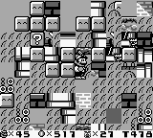
Crash Amplification
Many programs won’t even start with ASAN
Typical C is not sensitive to out-of-bounds accesses
So many programs have UAFs and slight OOB accesses that go undetected
Super Mario Land 2 let you walk through and manipulate RAM
Still “rarely” crashes
Notes:
Seriously. This SML2 bug is so easy to trigger and you can jump around modifying memory for typically 15+ seconds before crashing.

Slide 23
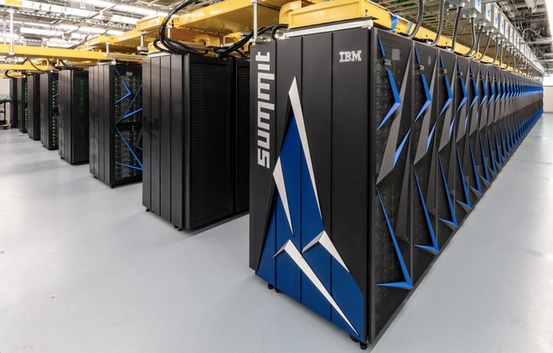
Performance
Improving performance almost always helps fuzzing
Duh
Linear scaling
Just because you can run multiple doesn’t mean you should
Most fuzzers are terribly slow
Things like AFL persistent mode help
But still fundamentally rely on disk access and syscalls

Slide 24
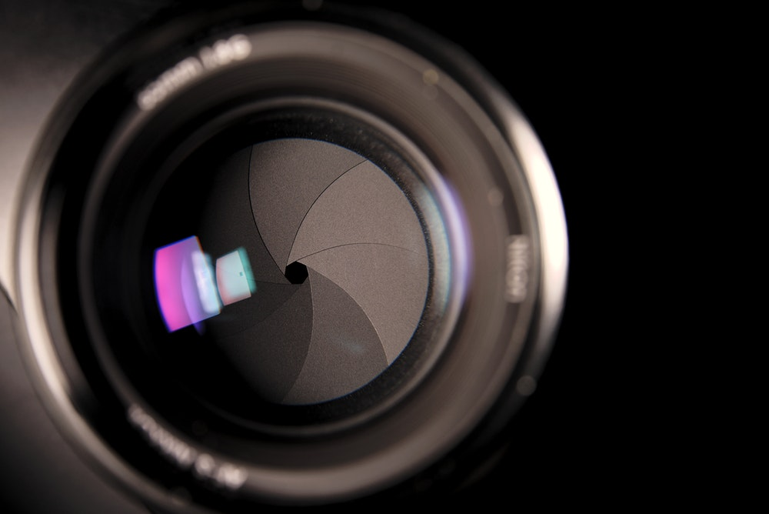
Snapshot Fuzzing
Create a snapshot of a running application/system
Usually just memory state and register state
Re-create the same environment and reload memory/register state
Continue execution with a new fuzz input
Typically the fuzz input is changed in-memory
Reset the program to original state when done
Deterministic
Bugs easily reproduce
Linearly scales with cores for performance
Notes:
Really hasn’t caught on
Not much tooling exists

Slide 25
A Journey through experience
Crashes waiting… up and down the call graph
Their corruption searching in the heap
Sigsegvs, c0000005s, living just to find exceptions
Hiding somewhere in the coooooooooooooode
Notes:
Yeah that’s a Don’t Stop Believin’ Remix
Don’t trip
We’re gonna go through the major tools I developed through my career
For every one of these major tools there were dozens of tiny scripts and hacks

Slide 26
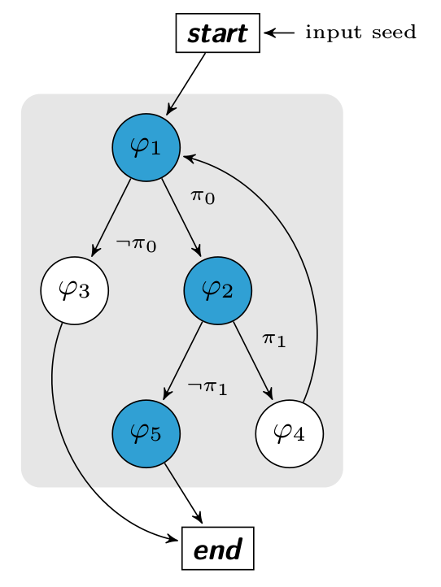
Starting Off
The first fuzzers I wrote were pretty simple
SVG fuzzer
Chrome DOM fuzzer
Neither really worked
Lost inspiration to focus on fuzzing
Symbolic and static analysis tools on the rise
Didn’t really understand the complexity
Sounded like the future to me
Notes:
This was approx. 2012

Slide 27
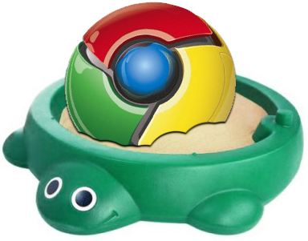
A New Target Appears
Chrome sandbox
Relatively new surface
Not much public research at the time
Limited attack surface
Surface varied based on platform
No trivial way to get inputs in
No trivial way to get sample traffic
Notes:
Approx 2013

Slide 28

Capturing Chrome IPC Traffic
Simple model on Windows
Named pipe to send serialized messages
Renderer <-> Browser
Renderer is unprivileged
Browser runs as a full privileged user app
Created custom debugger
Put breakpoint on ReadFile() on pipe in browser
Saved IPC traffic
Notes:
Was kindof wireshark for chrome IPC

Slide 29
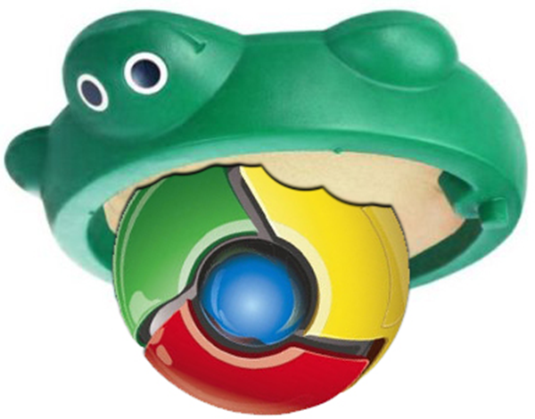
Feeding Captured Traffic Back
Gathered stats on observed IPC messages
Roughly 500 messages of 800 unique
Randomly replaced IPC traffic with old samples
Boom!
Quite a few unique crashes
No mutation
Added corruption a bit later
Notes:
Being able to get a live view of all chrome IPC traffic was so helpful
Gave me the ability to track the breadth of my corpus and try to generate browser traffic to increase the number
Seriously I’m pretty sure all chrome fuzzing was/is done on Linux. Back when I did this almost any Windows specific IPC message was just full of bugs
I think this still works, it found a few crashes in 2017 when I tried it again

Slide 30
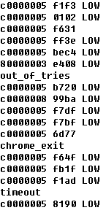
Hmm… maybe harnessing is good?
Didn’t read much Chrome code
Didn’t write a fuzzer
Didn’t really understand how the IPC worked
Just found a unique way of gathering/injecting IPC traffic
Still found critical bugs
… Maybe there’s something here?
Notes:
Picture on the right was some old chrome crash list I had laying around
LOW means null-deref (low address)
Things without LOW are typically more serious bugs
In this case they were both exploitable use-after-frees

Slide 31
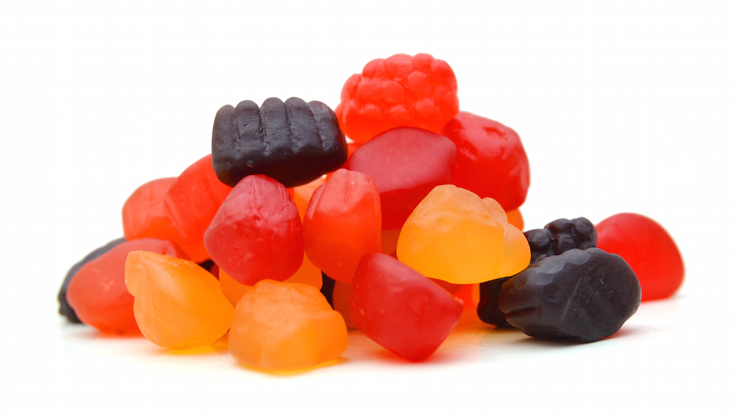
Improving Harnessing (fruitsnack)
Wrote a custom allocator for Chrome
Saved full stack on each alloc/free
Really just PageHeap++
Made it a DLL so I could quickly change it out
Didn’t reuse virtual addresses so UAFs were more easily detected
Got a few more crashes due to this
Triage was easier with full stacks
Notes:
Saving all of stack in a debug build is awesome. You can view all local variables in scope of all functions during allocs and frees and build a whole picture.
Downside is now chrome takes 40 GiB of RAM to run :D
Money can solve that problem, RAM is cheap (especially was in 2014 when I did this)

Slide 32
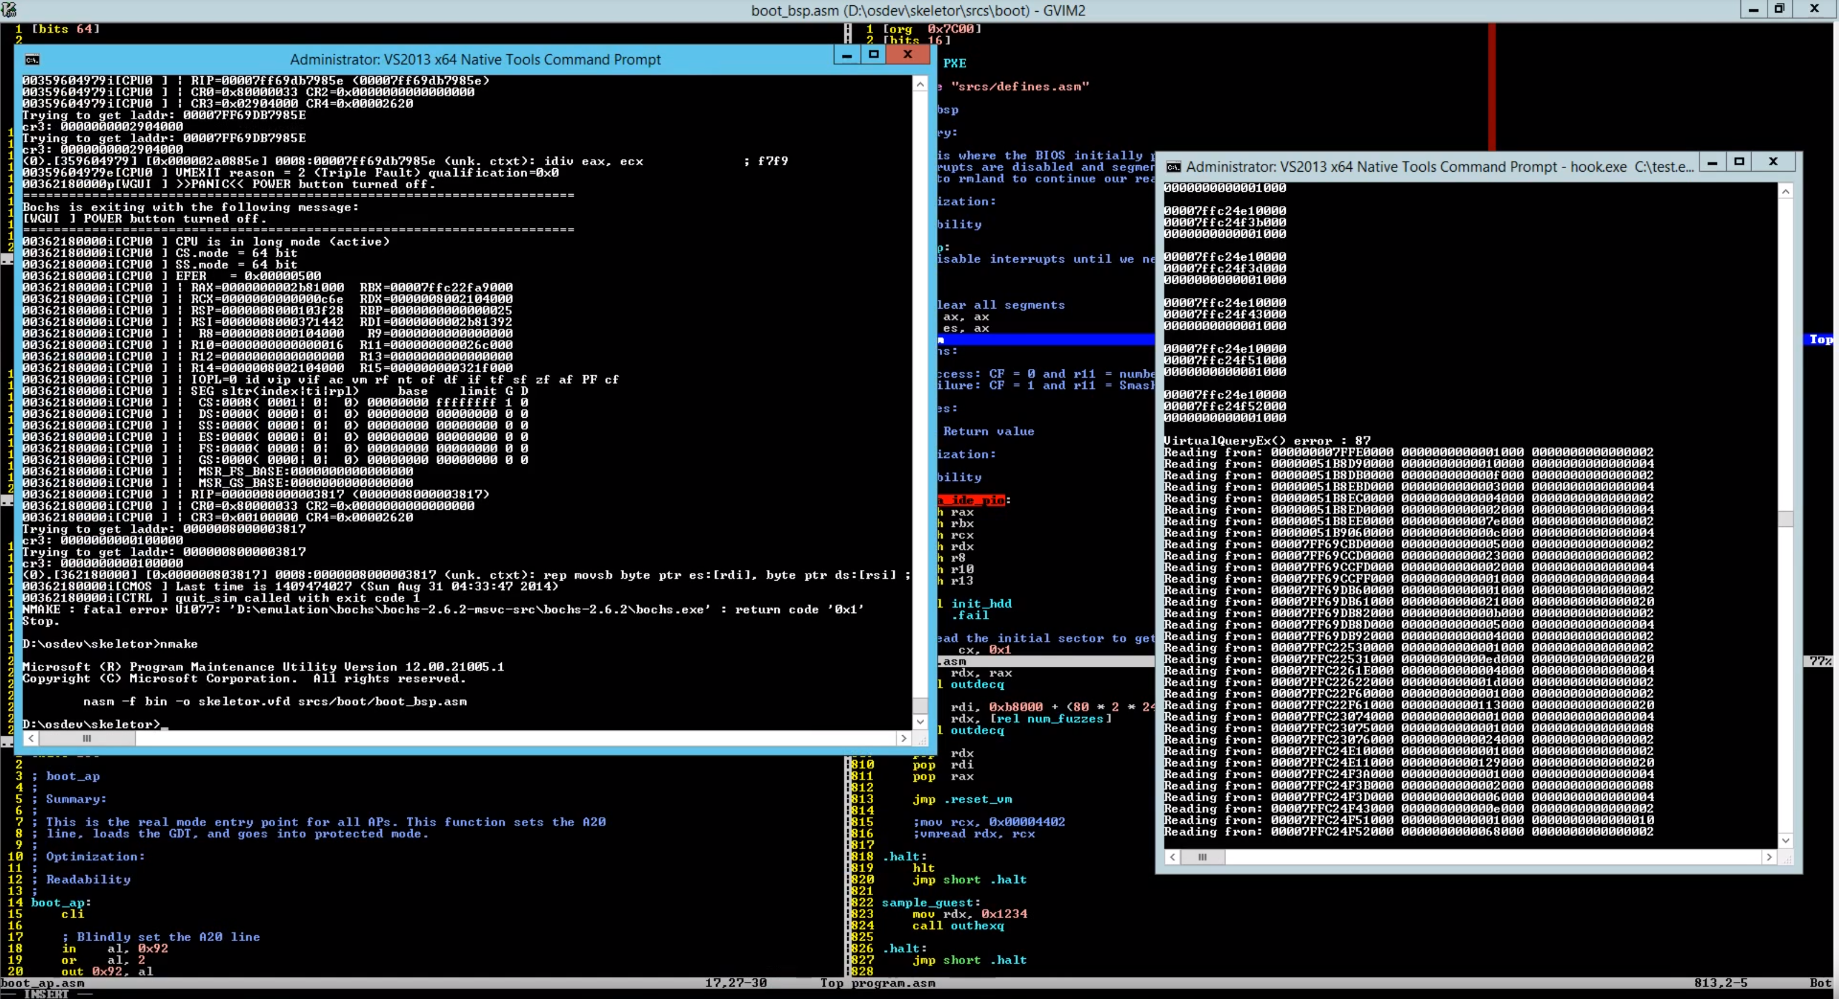
A new era
Notes:
Screencap of my first hypervisor video on youtube.

Slide 33

A new era (skeletor)
Already had a background in osdev
Wanted to write a hypervisor
Why not fuzz targets under a hypervisor?
First version took a snapshotted Windows application and loaded it up in a VM
I made a video about it in 2014
https://www.youtube.com/watch?v=bJbfYf89xMc
Couldn’t fuzz systems, only applications
Performance was pretty meh
Notes:
Don’t talk much about the hypervisor. We’re just glossing over it. We talk about fuzzing with hypervisors as a concept later
This was written all in assembly
2014 I think

Slide 34
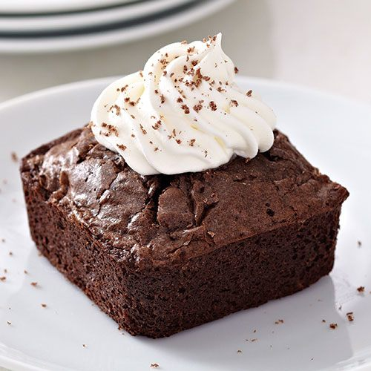
Fuzzing systems in a hypervisor (brownie)
skeletor + more code = fuzzing systems
Breakthrough: Dirty-bit based restores
Only restore pages that were modified during the fuzz case
3 hour Q&A about it:
https://youtu.be/7Yjvk_RG5a0
5 hour video of using it to fuzz:
https://youtu.be/AqFMSI8e9Qo
Source
https://github.com/gamozolabs/falkervisor_beta
Notes:
Don’t talk much about the hypervisor. We’re just glossing over it. We talk about fuzzing with hypervisors as a concept later
Written in assembly still, I’m an idiot

Slide 35
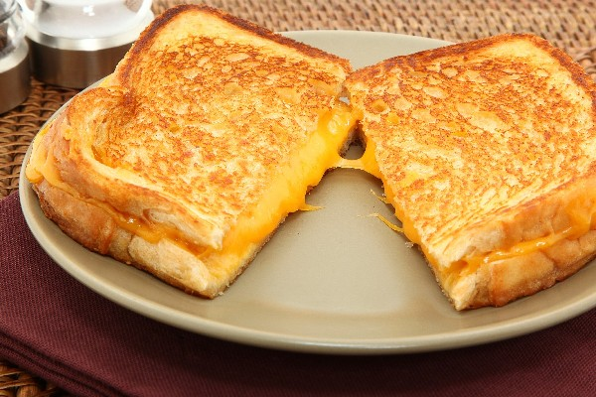
grilled_cheese
brownie but written in C
https://github.com/gamozolabs/falkervisor_grilled_cheese
Fuzzed Windows Defender and Word RTF parsing @ ~4000 fcps
8+ ways of gathering code coverage
NUMA support, dirty page restoring, CoW support
The more shared memory the better
Found dozens of unique RTF parsing bugs
Found one uninitialized pointer use in Defender
Found some Chrome IPC, pdfium, Edge PDF bugs
Notes:
Don’t talk much about the hypervisor. We’re just glossing over it. We talk about fuzzing with hypervisors as a concept later
Ayy it’s in C now
Hell yeah I did Defender before it was cool
2014 still? Maybe 2015

Slide 36

Wait what? Fuzzing with a hypervisor?
Snapshot mode
Hypervisor was booted over PXE first
Created a VM and booted off disk inside of it
Whatever is on disk is what ran. Linux? Windows? Doesn’t matter.
When a hardware breakpoint was triggered with a magic value in a register, a snapshot was taken
gdb and WinDbg could be used to find the right condition to snapshot
The system image was sent over the network for future use
System rebooted when desired snapshots were taken
Notes:
Okay now we talk all day about fuzzing with hypervisors

Slide 37
Wait what? Fuzzing with a hypervisor?
Fuzz mode
Previous taken snapshot was loaded over the network
Technically an empty VM was created and pages were faulted in as needed
Fuzzer modified input file/packet/etc in memory in the guest
Sometimes used breakpoints if there were multiple input locations
VM was run tracking for new coverage and crashes
VM completes (timeout, crash, MMIO, returned from parser)
Only memory modified during fuzz case was reset
Notes:
Resetting the VM was about 3-4% of CPU time. This made it easy to go ham with crash feedback.
Lots of room to explore weird situations as discarding them and resetting cost almost nothing (milliseconds)

Slide 38
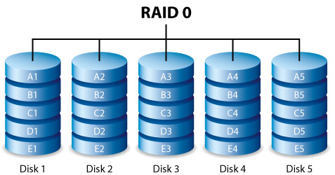
Multiple Snapshots
Word RTF had way too many bugs
I bottlenecked on triage
Took multiple snapshots and ran the same input through
All the crashes were grouped together as it was the same input
This tooling took me from hundreds of thousands of “unique” crashes to just about 15-20 or so
Mixing in PageHeap/ASAN snapshots further helped root cause bugs
Notes:
Seriously Word RTF was so bad…
I had I think 3 arbitrary EIP control bugs, meaning I effectively had 4 billion unique crashes
I even had a Word RTF crashing input that also crashed LibreOffice, was kinda fun to have 2 programs crash from the same input without intentionally setting it up

Slide 39

Emulation
I was mainly doing Android research at this point
My x86 hypervisor tooling was useless
Started playing with QEMU for various Android targets
Added hooks for gathering code coverage and feedback
Notes:
I still hypervised in my freetime but Android was just too juicy to turn down.
2015

Slide 40
Emulation Improved
QEMU’s MMU wasn’t very fast
Wrote a custom page-table based MMU for QEMU
I could use any page shape I wanted
What about 1-byte pages?
Using 1-byte pages I was able to get byte-level permissions
Added hooks to allocators to modify permissions to the byte
Out-of-bounds by 1 now caused crashes
Works on binary targets, no source/rebuild needed
This was effectively ASAN-level permissions on binary targets
Notes:
Made resetting a lot faster as well
Could then do crash feedback trivially

Slide 41

Winner Winner!
Byte level MMU was a massive success
Found loads of new bugs because of this
Later some were discovered to go further out-of-bounds
Without the initial 1-byte OOB it never would have been prioritized
Notes:
Seriously this is really important, do this

Slide 42
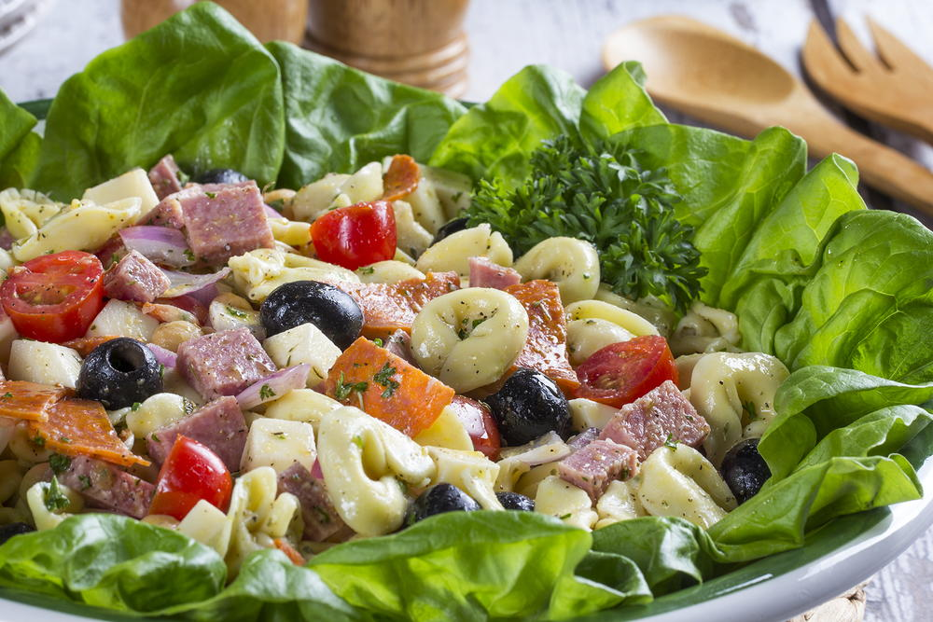
Ditching QEMU (salad)
QEMU wasn’t designed for fuzzing
Some things were abstracted for performance
Blocks
Register state not always being in sync
Wrote a naïve emulator for MIPS32
High introspection
Linear scaling with cores
Byte-level MMU support
Registers/memory always in sync
Eventually added JIT
Notes:
QEMU isn’t designed for fuzzing but quite honestly almost nothing is
There are generators and mutators out there, but really nothing that is a whole system for fuzzing
AFL just abuses fork() in a way not intended
Libfuzzer still has huge overhead on resets on crashes
Unicorn has terrible performance for hooks, and also is slow to reset
2016

Slide 43
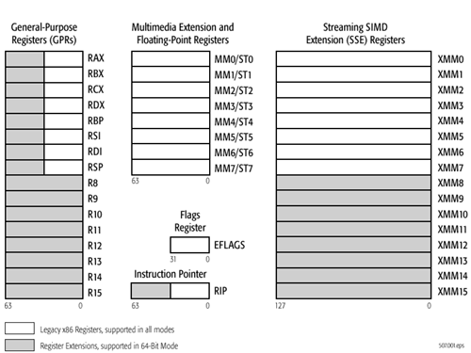
Register Coverage
Why not add register state tracking in salad?
On register loads and stores record register state
State explosion!
Track only minimum/maximum values observed
Limit each PC to only n inputs
Had some success finding bugs in common code paths but obscure states
Mildly successful
Limited by the mass amount of data produced
Notes:
This increased inputs by about 1000x, making it infeasible
I track fuzzing often by fuzz-cases-per-input, try to pin it to 100 (each input was fed through 100 times)
If you gain coverage faster than you can fuzz then there’s no point in doing feedback

Slide 44

Rust
Corruption bugs in my own tools
Uncomfortable with results
Lost a few weeks of progress due to my own bug
Started trying out Rust
Somehow really liked it even though I hated anything higher level than C
Ported all my tools to Rust
Hypervisor
Emulators
Misc tools
Notes:
Preach
Late 2016

Slide 45
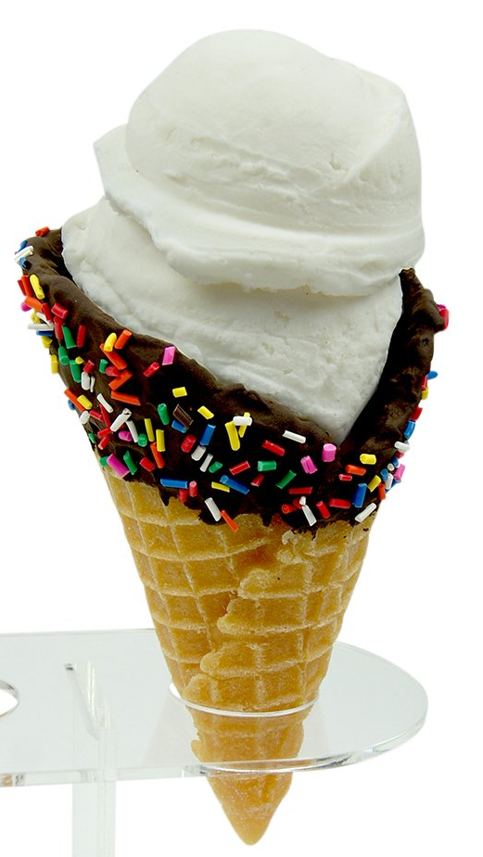
Vectorized Emulation (wafflecone)
Run multiple VMs per core using AVX-512 instructions
16 32-bit VMs per core
8 64-bit VMs per core
Best case scenario: 2 trillion instructions per second
Average case 80 billion per second
That’s about 100k fcps for small targets
Almost all existing tech baked in:
Code coverage
Byte-level MMU
Register and memory coverage
Dirty bit restores
Notes:
Still trying to find ways to describe this tech
Early 2017

Slide 46
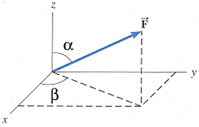
Vectorized Emulation
Differential coverage
Only record coverage for registers/code paths which are user-influenced
Register coverage now feasible
Added uninitialized memory tracking
Read-after-write (RaW) memory
RaW memory faults on reads unless written to prior
Byte level as well
Can fuzz portions of code without snapshots due to RaW memory
Just set PC to point to a function, mark all writable sections as RaW
Fill in globals/structure fields as needed
Helps fuzz targets you could never run
Notes:
Look at all those features
You thought fuzzing targets without source is hard?
Try fuzzing targets you can never run
Or targets which you have lossy leaks of and maybe only have a portion of the binary

Slide 47
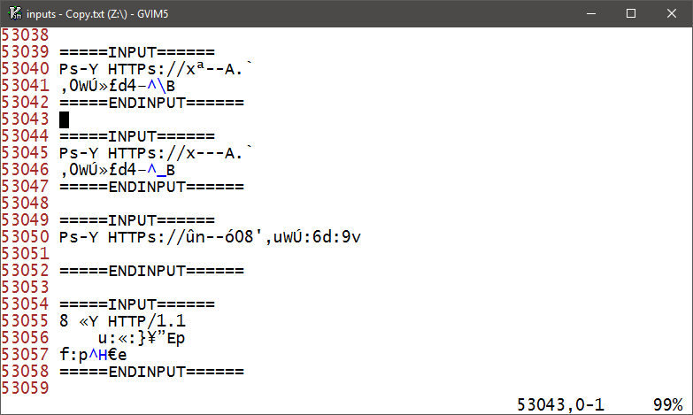
Vectorized Emulation
“Solvers”
Feedback based on closeness during compares
Feedback based on register state
Byte flipper finding magic strings like “HTTP/1.1” almost instantly
Notes:
It doesn’t look that impressive but this is a byte flipper with _no_ knowledge of the target
In seconds it was discovering magic strings (not via some feedback of strings in the binary either)
Just through observing program state and trying to classify which inputs were important
There’s going to be a whole detailed blog on the implications and limitations of this “solving”
It’s really neat. It won’t solve P=NP, but it might get you an extra little bit on your fuzzer

Slide 48
Breathe
I’m probably talking too fast at this point
Notes:
Seriously, this talk should be at like 50 min by now but there’s a chance I blew through it in 20 min. It’s also possible you never see this slide because I went on way too big of a tangent.

Slide 49
Modern Day
wafflecone being rewritten for cleanliness
Using a graph based IL versus block based
Designed to be used rather than a proof-of-concept
Which tool do I use?
Hard targets: wafflecone / falkervisor / creative juice
Medium targets: Custom debuggers like I used for Chrome IPC
Soft targets: Literally anything
What’s the right solution?
There is no right solution
All targets should be approached uniquely
Notes:
Last bullet here is the most important takeaway
I’ve got thousands of hours in tool dev, covering many different techniques
I still bang out python scripts to fuzz new targets
Sunk cost is bad. Don’t use tools just because you have them
Get creative

Slide 50
Questions?

Slide 51
Resources
Hypervisor coverage slides
https://docs.google.com/presentation/d/15NvwXRWMSpOxOjt8gnSbj6marZ9U3a3GwQ2sZo3JxxM/edit?usp=sharing
Falkervisor
https://github.com/gamozolabs/falkervisor_grilled_cheese
https://github.com/gamozolabs/falkervisor_beta
https://www.youtube.com/watch?v=bJbfYf89xMc
https://www.youtube.com/watch?v=7Yjvk_RG5a0
https://www.youtube.com/watch?v=AqFMSI8e9Qo
Vectorized emulation
https://gamozolabs.github.io/fuzzing/2018/10/14/vectorized_emulation.html

Slide 52
Random points
Fuzz cases per input is a useful metric
Got 100k inputs but getting 10 fcps?
Most performance on fuzzing tools is terrible
Fuzz in-memory if possible
I personally restart my fuzzing from scratch each run
If you start from a known coverage state/input database you might mask that your fuzzer is broken
“Oracle” crashes are awesome
Div by zero?
Null deref?
May be useless, but it gives you a reference point
Are you spending lots of CPU time in the kernel?
You’re probably not fuzzing much (forking? Disk I/O?)
Notes:
Not trying to roast fuzzing tools but usually there’s a 100x speedup somewhere in there. Usually this is in the reset costs. Just because you are at 100% CPU usage doesn’t mean you’re effectively using the CPU.
In almost all of my snapshot fuzzers (emulators and hypervisors) my reset time is always <5% of total CPU time when fuzzing. I typically spend 90% of CPU time inside of the VM running actual target code
It’s common for fuzzers to save inputs/crashes and reload them on a new run, I of course save inputs and crashes but usually start from scratch each time
Imagine you completely ruin your fuzzer but still reload old crashes… you still will get all the crashes and might not know you are running from a broken state
This also gives me an incredibly good reference point. I compare previous fuzzer runs with the current one. Does the new one get more coverage faster, more crashes faster? You probably improved it.

